Slide 1

Ideal ML/AI Scenario
Prepare a Master Dataset
Train & Test different ML Algorithms
Finalize the best Algo for the use case
5 days
10 days
15 days
30 Day Effort
Data Servers

Slide 2
CUrrent Scenario
Prepare a Master Dataset
Train & Test different ML Algorithms
Finalize the best Algo for the use case
?? Day Effort
Current off-chain APIs (Plaid/Intuit etc) are not DaaS APIs & thus require time & effort searching for such APIs
DaaS APIs

Slide 3
APIs Reviewed
Categories
Covalent
Intuit
Yapily
FUD Index
On-Chain:
Relevant for ML
Plaid
Lexus Nexus
FormFree
Ceramic Network
On-Chain:
Relevant but not for ML
Nansen
The Graph
Finicity
DeFi Score
Off-Chain:
Relevant for ML
Zabo
Nordigen
Fractal
Off-Chain:
Relevant but not for ML
SigmaRating
TrueLayer
Yapily
Off-Chain:
For Europe

Slide 4
APIs analyzed
On-Chain:
Relevant for ML
On-Chain:
Relevant but not for ML
Off-Chain:
Relevant for ML
Off-Chain:
Relevant but not for ML
Off-Chain:
For Europe
Covalent
Nansen
Lexus Nexus
Intuit
Nordigen
The Graph
FUD Index
SigmaRating
Plaid
TrueLayer
Results Conclusive : Accepted
Ceramic Network
Zabo
Yapily
Under Evaluation
DeFi Score
Results Conclusive : Rejected

Slide 5
Off–chain model : Distn of Lending accts
Mean = 760 & Std dev = 65

Slide 6
Off–chain model : adaption to teller points
Mean = 80% & Std dev = 14%
Credit Score Normalized between 0 and 1

Slide 7
Off – chain model : How to decide the LOAn AMOUNT $$
Slope : 16.7
Slope : 37.9
Slope : 5.25

Slide 8
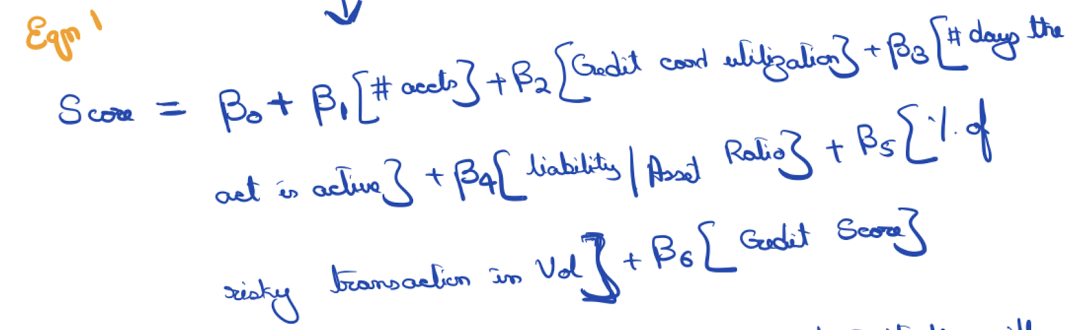
2 options
A Simplistic Approach :
Key Caveat : Requires Credit Score
A much more iterative and calculative oriented approach
Key Takeaway : can work without credit score

Slide 9
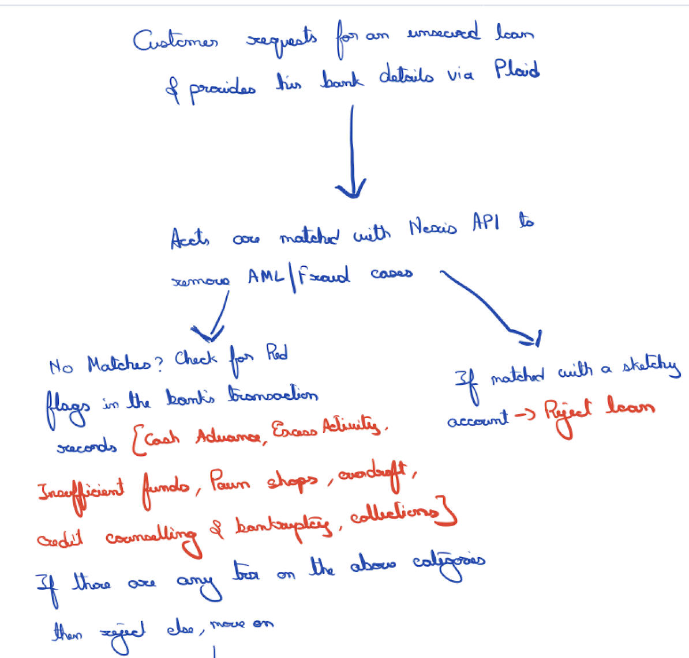
Initial SCRUBS

Slide 10
On Chain Model workflow
Nansen Validation Phase
Amount Decision phase
Model Phase
Covalent
Graph
DeFi Score
Algorithm Score -- Ex: 70/100 for Acct A
 | FUD Index
Teller Score | 0-10 | 11-20 | 20-30 | 40-50 | 50-60 | 60-70 | 70-80 | 80-90 | 90-100
0-10 | 0 | 0 | 0 | 0 | 0 | 0 | 0 | 0 | 0
11-20 | 0 | 0 | 0 | 0 | 0 | 0 | 250 | 0 | 0
20-30 | 0 | 0 |  | 0 | 500 | 600 | 600 | 600 | 600
40-50 | 0 | 500 | 500 | 600 | 1000 | 1100 | 1100 | 1100 | 1100
50-60 | 500 | 700 | 800 | 1000 | 1500 | 1600 | 1600 | 1600 | 1600
60-70 | 600 | 800 | 1100 | 1400 | 2000 | 2300 | 2400 | 2500 | 2600
70-80 | 700 | 900 | 1400 | 1800 | 2500 | 3000 | 3200 | 3400 | 3600
80-90 | 800 | 1000 | 1700 | 2200 | 3000 | 3700 | 4000 | 4300 | 4600
90-100 | 900 | 1100 | 2000 | 2600 | 3500 | 4400 | 4800 | 5200 | 5600
Wallet tagged as High Value Wallet
Min(70*Multiplier,100) = 84
Multiplier = 1.2 (since High Value)
The numbers shown above are for illustrative purposes
This example is for those accts that have not shared any off chain data with us

Slide 11


Next Steps
On – chain model workflow
Decide the weights & the features to assign to each feature

Slide 12
Appendix

Slide 13
Nansen Data Labels
Labels | Tags | Multiplier
Smart Money | Smart LP | 1.05
 | Flash Boys | 1.05
 | 0x_b1 | 1.05
 | Whale | 1.10
 | Fund | 1.0
High Value | Millionaire | 1.2
 | Billionaire | 1.2
 | ETH Millionaire | 1.25
 | ETH Billionaire | 1.25
 | Token Millionaire | 1.25
 | Token Billionaire | 1.25
 | High Balance | 1.2
Trader | Dex Trader | 0.95
 | Medium Dex Trader | 0.95
 | Heavy Dex Trader | 0.95
 | Elite Dex Trader | 1
 | Diversified Token Holder | 1.25
 | High Gas Consumer | 1.15
 | High Activity | 1.1
 | Sandwich Attack Victim | 1.05
 | Sandwich Attack Contract | 1.05
 | Sandwich Attacker | 1.05
 | MetaMask Swap User | 1.05
 | 0 Gas Price Sender | 1.05
 | Cold Feet | 1.05
 | Warm Feet | 1.05
NFT Collectors | NFT Collector | 1.05
 | Uncommon NFT Collector | 1.05
 | Rare NFT Collector | 1.05
 | Epic NFT Collector | 1.05
 | Legendary NFT Collector | 1.05
 | OpenSea Account | 1.05
Sales | Presale | 0.95
 | Token Sale | 0.85
 | Distributor | 1
Other | Mixer | 1
 | Empty Contract | 1
 | Mining Pool Recipient | 1
 | Scam | 0.7
 | CDP Creator | 1
 | Token Contract | 1
ILLUSTRATIVE DATA

